Slide 1

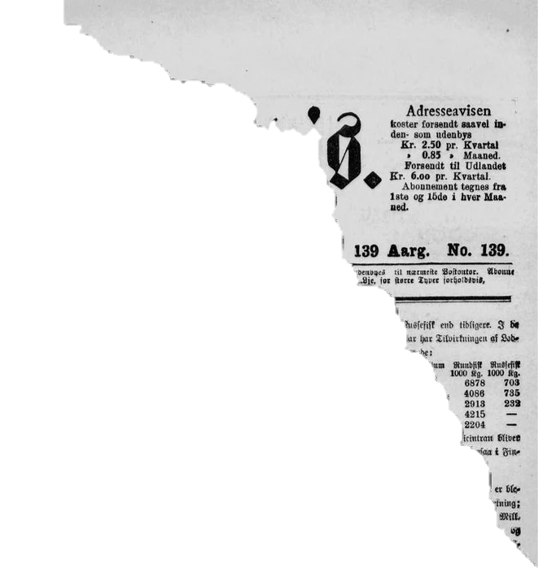
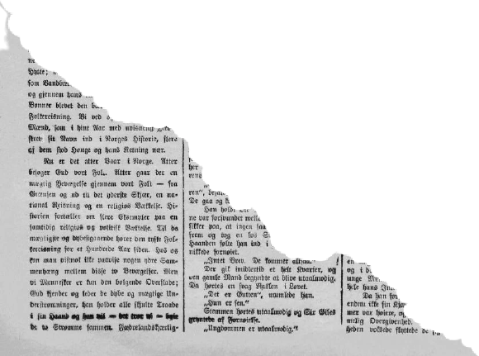
WOMEN
W O M E N
Safety and Alert System

Slide 2





MEMBERS
NAME | GR.NO | ROLL NO. | BATCH
HARSH ABICHANDANI | 21810936 | 323001 | C1
MUSKAN AGARWAL | 21810223 | 323002 | C1
PRANALI AHIRRAO | 21810302 | 323003 | C1
AYUSHI AHUJA | 21810872 | 323004 | C1

Slide 3


SAFETY AND SECURITY
SENSORS
EMERGENGY
NEVER BE BULLIED INTO SILENCE.
NEVER ALLOW YOURSELF TO BE MADE A VICTIM….
-------------------------
HARASSMENT
IOT
ALERTING
-Harvey F.
LOCATION

Slide 4


INTRODUCTION
India which sees itself as a promising super power and an economic hub, is still trapped in the clutches of various patriarchal evils like molestations, crime against women, worst among all is rape.
So, Women safety has become a major issue as they can’t step out of their house at any given time due to fear of physical/sexual abuse and violence.
So, in an attempt to curb this menace,
We have designed a mini version of a security system that is designed merely to serve the purpose of providing security to women so that they never feel helpless while facing such social challenges.

Slide 5



OBJECTIVE
To create a safety system in the form of a portable safety device for women, that does the following tasks:
Alerts family and police by sharing the message and voice call coordinates of the woman being attacked.
Incorporates a technique of automatically turning the device ON by monitoring the values of different sensors used and functions in the following way.
A day when media broadcasts more of women’s achievements rather than harassment, it’s a feat achieved! Since we (humans) can’t respond aptly in critical situations, the need for a device which automatically senses and rescues the victim.

Slide 6



BLOCK DIAGRAM
LCD- Liquid Crystal Display
Arduino uno
Global System for Mobile Communication.
LCD DISPLAY
GSM Module
LED
LED-Light Emitting Diode
VIRTUAL TERMINAL
VIRTUAL GPS
Global Positioning System

Slide 7
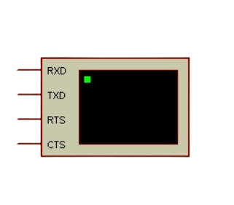
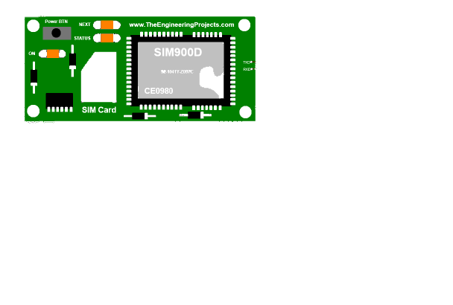
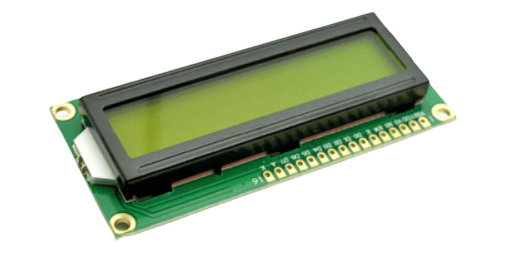
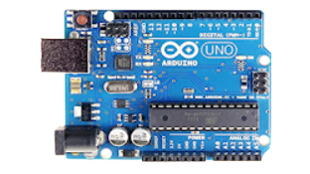
COMPONENTS
Arduino Uno
GSM Module (SIM900D)
GPS Module (VIRTUAL GPS)
LED-light emitting diode
16×2 LCD Module
10K Variable Resistor
Resistor of 220 Volt for led

Slide 8
COSTING
Arduino Uno
GSM Module (SIM900D)
GPS Module (VIRTUAL GPS)
LED-light emitting diode
16×2 LCD Module
10K Variable Resistor
Resistor of 220 Volt
wires
Rs. 350
Rs. 1199
Rs. 499 (Not for virtual)
5mm(red/blue/green): Rs 10 each
Rs. 88
Rs. 69
Rs.34
Rs. 50(per bundle)
Approximate Total: Rs. 2299

Slide 9
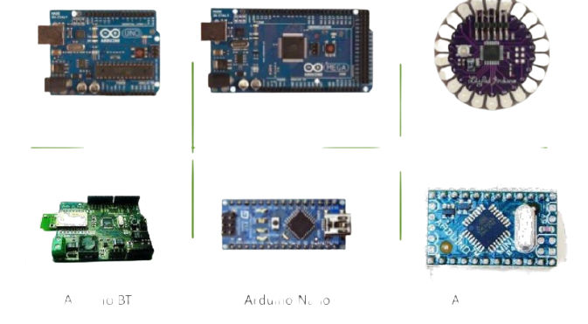
ARDUINO
UNO
It is an open source computer hardware and software
based On the Microchip ATmega328P microcontroller
It is designed to use a variety of microprocessors and controllers.
The boards are equipped with sets of digital and analog input/output (I/O) pins that may be interfaced to various expansion boards (shields) and other circuits.
14 digital I/O pins, 6 analog I/O pins, and is programmable with the Arduino IDE
BT
NANO
MEGA
LILYPAD
MINI

Slide 10
GSM MODULE
Global System for Mobile (GSM) is a second generation cellular standard developed to cater voice services and data delivery using digital modulation.
COMMANDS TO MAKE CALL :
AT+CHFA = 1
AT+CMIC = 1
ATD092341434445
ATH
ADVANTAGES OF GSM MODULE:
✓ Communication – mobile, wireless communication, support for voice and data services
✓ Total mobility – international access, chip-card enables use of access points of different providers.
✓ Worldwide connectivity – one number, the network handles every location.
✓ High capacity – better frequency efficiency, smaller cells, more customers per cell.

Slide 11
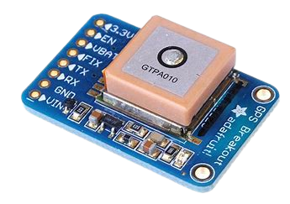
GPS MODULE
• A Global Positioning System (GPS) navigation device, GPS receiver, or simply GPS is a device that is capable of receiving information from GPS satellites and then to calculate the device's geographical position.
• Using suitable software, the device may display the position on a map, and it may offer directions.

Slide 12
LCD MODULE
• A liquid crystal display (LCD) is a thin, flat panel used for electronically displaying information such as text, images, and moving pictures.
• Its uses include computer monitors ,televisions , instrument panels, and devices ranging from aircraft cockpit displays, to every-day consumer devices such as clocks , calculators, and telephones.

Slide 13
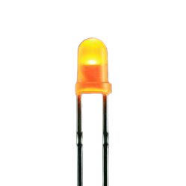
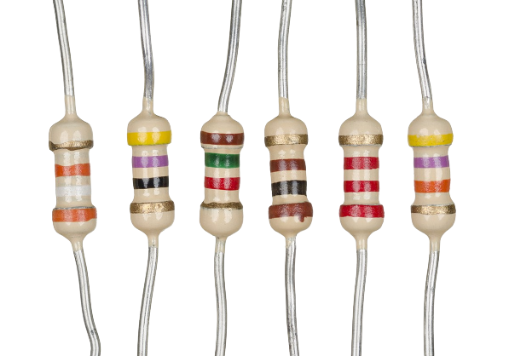
LED
A light emitting diode (LED) is essentially a PN junction opto- semiconductor that emits a monochromatic (single color) light when operated in a forward biased direction.
LEDs convert electrical energy into light energy.
RESISTOR
It is a passive two-terminal electrical component that implements electrical resistance as a circuit element.
• In electronic circuits, resistors are used to reduce current flow, adjust signal levels, to divide voltages, bias active elements, and terminate transmission lines, among other uses.

Slide 14

Circuit Diagram
Our intention is to provide you with fastest and simplest way to contact your nearest help

Slide 15
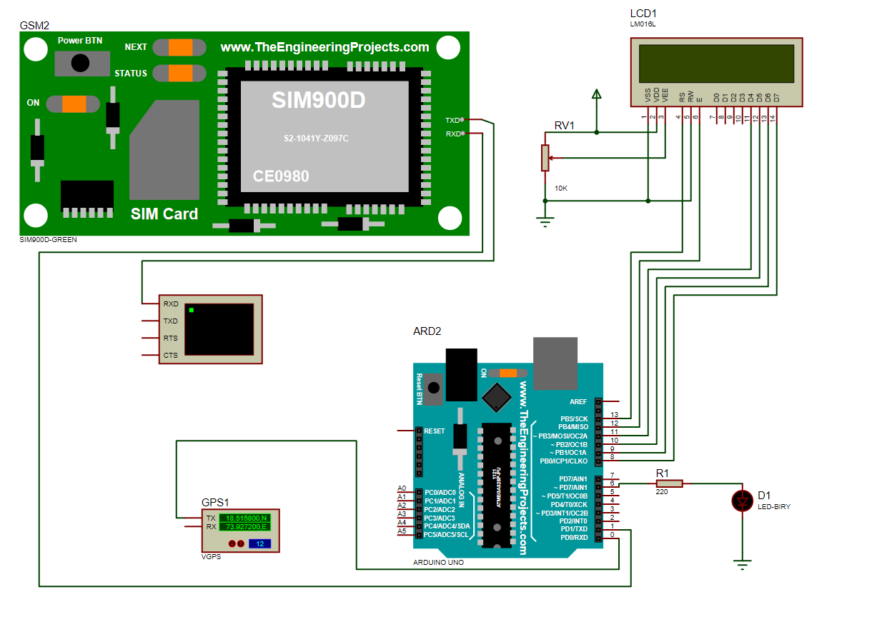

Slide 16
void loop()
{
digitalWrite(LED_RB, HIGH); // turn the LED on (HIGH is the voltage level)
delay(100); // wait for a second
// digitalWrite(LED_RB, LOW); // turn the LED off by making the voltage LOW
// delay(100);
lcd.setCursor(0,0); //display latitude and longitude on 16X2 lcd display
lcd.print("Lat(N)=18.515800");
lcd.print(latitude);
lcd.setCursor(0,1);
lcd.print("Lon(E)=73.927200");
lcd.print(logitude);
delay(1000);
lcd.clear();
lcd.print("Sending SMS");
#include<LiquidCrystal.h>
LiquidCrystal lcd(13,12,11,10,9,8);
char logitude[10];
char latitude[10];
//int Ctrl+z=26; //for sending msg
const int LED_RB = 6;
void setup()
{
lcd.begin(16,2);
Serial.begin(4800);
pinMode(LED_RB, OUTPUT);
lcd.setCursor(0,0);
lcd.print("WOMEN SAFETY");
lcd.setCursor(0,1);
lcd.print("ALERT SYSTEM");
delay(3000);
}

Slide 17
Serial.begin(9600);
Serial.println("AT+CMGF=1"); //select text mode
delay(10);
Serial.println("AT+CMGS=\"91**********\""); // enter receipent number
Serial.println("Danger Alert:");
Serial.print("PLEASE HELP ME!!!!"); //enter message
Serial.print("I am in danger ");
Serial.println(" ");
Serial.println("Lon(E)=73.927200"); //enter longitude value in msg
Serial.println("Lan(N)=18.515800");
Serial.print("https://maps.app.goo.gl/txKo7NWiz3cD2rsy7");
lcd.clear();
lcd.print("SMS Sent");
delay(20000); // next reading within 20 seconds
Serial.begin(4800);
}
CODE

Slide 18


ADVANTAGE
It is safe and easy to use.
It can be used by children, teenager girls, women, old lady or old men.
Mobile number can be changed at any time.
Flexible one • Low cost • Less weight
• Easy coding & maintenance
Minute variations also captured by the sensors

Slide 19

DISADVANTAGE
Major deficiencies of such system are poor internet connection, defective instrument,
Defective instruments(sometimes)
When the power will turns OFF, then the total system will turn OFF,
so battery is always required .
SIM card is needed for GSM module.

Slide 20
APPLICATIONS
Smart gadgets- apps in mobile phones( example: my safetipin, bsafe, Rescuer)
Smart watch.(APPROX RS.2000)
Nirbhaya safety shoes- Taser shoes
The woman’s safety device with GPS tracker can be used while walking through the dark street at night.
This project is also useful in case of an accident.
Can be used to get rid of robbers.

Slide 21

Danger Detection by Scream

Slide 22
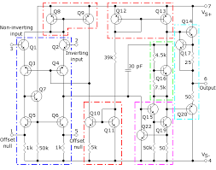
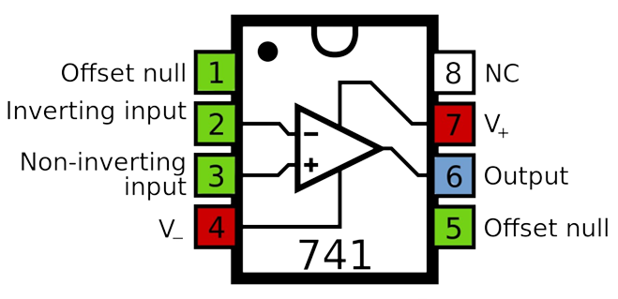
COMPONENTS
A typical IC 741 is constructed with a circuit that is included with 11 resistors and 20 transistors.
Some Applications are :-
Integrator
Differentiator

Slide 23
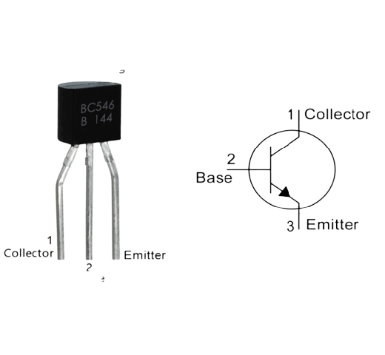
BC546 transistor can be used in wide variety of general purpose applications, it can be used as a switch to control loads under 100mA.
It can easily be used voltages under 65V. Apart from that the transistor also possesses some very good characteristics that make it ideal to use in audio amplification related applications or other signal amplification purposes.
Some Applications:
Audio Preamplifiers
High gain Audio Amplifier Stages

Slide 24
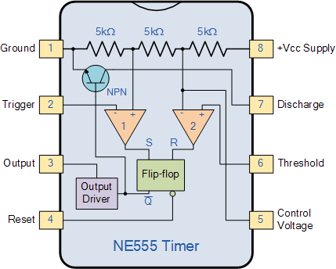
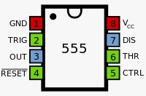
Some applications:-
such as one-shot or delay timers, pulse generation, LED and lamp flashers, alarms and tone generation, logic clocks, frequency division, power supplies and converters etc, in fact any circuit that requires some form of time control as the list is endless.
The 555 timer IC is a very cheap, popular and useful precision timing device which can act as either a simple timer to generate single pulses or long time delays, or as a relaxation oscillator producing a string of stabilized waveforms of varying duty cycles from 50 to 100%.

Slide 25
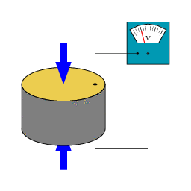
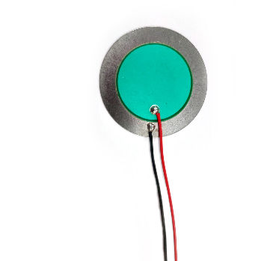
Piezo Element

Slide 26
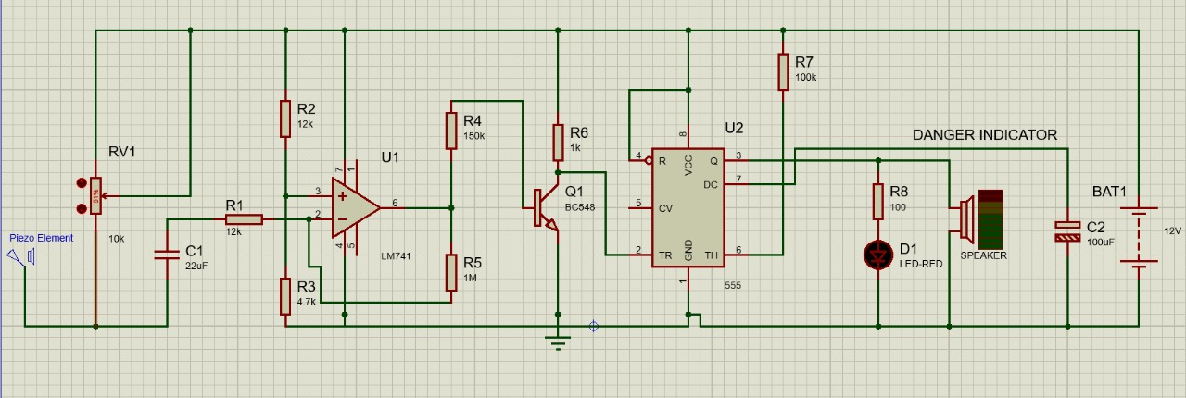
Circuit Diagram

Slide 27

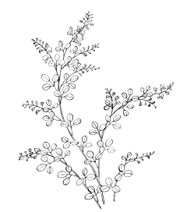

Through study and analysis, the wireless automated security system for women was studied. This system based on GSM technology
Another small enhancement to our woman safesty system was the scream detector that detected amplitude of sound using piezoelectric effect was successfully explained and simulated using Proteus software.
This device will be very much useful to women, whenever they went outside alone.
It is practically possible one and economically comfort to use.

Slide 28


